Slide 1
IT solution for reporting MiFIR Transactions
10-05-2017 - Finanstilsynet

Slide 2
Agenda
Test
Test overview
Test time schedule
Registration for test
Test cases
Known defects
FTP-server
Security set-up and information
Recap and recommendations
Information and communication
AOB
Notes:
ABU-slide

Slide 3
1. System overview
Submitting firm
TRS II
ESMA
Other CA’s TRS
Reference data
Submitting firm reporting system
Data reception
Transaction exchange
Transaction
exchange
Data reception
Internal systems
Internal systems

Slide 4
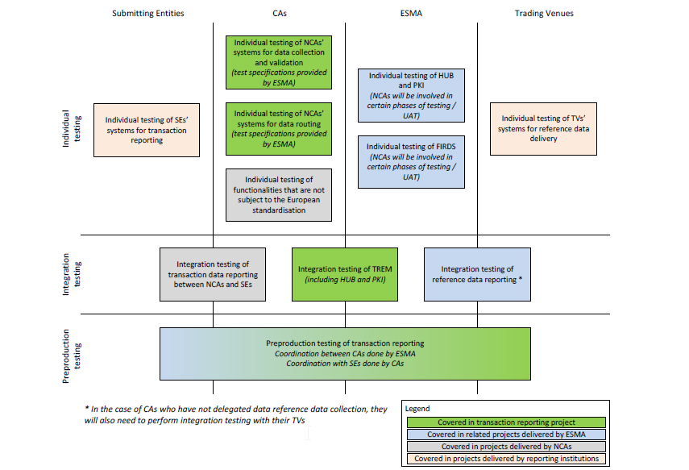
1. ESMA - Test overview
Notes:
ABU-slide

Slide 5
1. TRS II Expected release plan
Release 1
The TRS II is ready for external testing by submitting entities. They are able to send and receive data. May include validation based on reference data created by the project
Release 1,5
The TRS II is ready for testing exchange of data with other competent authorities and for receiving reference data from ESMA
Release 2
The TRS II is ready to comply with EU regulations
Maj 2017
September 2017
November 2017
Notes:
ABU-slide

Slide 6
1.Test Expected Time Schedule
Release | Start date | End date | Test
1 | May 2017 | Sep. 2017 | Part 1: Test of connection FTP-server Part 2: Test of validation of transaktion reports
1.5 | Sep. 2017 | Nov. 2017 | Test with reference data from ESMA (if available)
2 | Nov. 2017 | Dec. 2017 | A: Test of production release B: Pre-production with production data
 | 03-01-2018 | - | Go-live, Production
Notes:
ABU-slide

Slide 7
1. Test - Release 1
Notes:
ABU-slide

Slide 8
1. Reference data for Release 1 test
In Release 1 we do not have connection to ESMA’s FIRDS system and we will therefore strive to include the most common Danish instruments, LEI, MIC etc.
ESMA’s plan is to go live with FIRDS July 2017
Once FIRDS is up and running at ESMA with good data quality then TRSII will use the reference data supplied by FIRDS.
Notes:
ABU-slide

Slide 9
1.Test plan - Release 1
Start date | End date | Test
29-05-2017 | 01-09-2017 | Part 1: Test of connection to FTP-server
15-06-2017 | 01-09-2017 | Part 2: Test of validation of transaktion reports
01-07-2017 | 07-08-2017 | Summer vacation – no support from Finanstilsynet or BEC
September |  | Send test report for release 1 to all
Notes:
ABU-slide

Slide 10
1. Registration for test and production
Registration for test is done by:
Read instruction
Fill in the registration form
Send registration form to Finanstilsynet by email
Send SSH key pairs to BEC via email
Notes:
ABU-slide

Slide 11
1. Test Cases
We have prepared test cases that we will ask you to perform
Test cases for Release 1 is made and ready
Test cases for Release 1.5 and 2 will be published later
Notes:
ABU-slide test cases til connection ANT til test validering

Slide 12
1. Known defects
Feedback file doesn’t adhere to xsd. Two problems:
A simple one that will be fixed asap.
A more complex one: the name of the files are too long to fit into the 35 character limitation by ESMA. Eg.
<BizMsgIdr>FF_TR_353800XVAQXELVCPC871_01_20170407_0092_01</BizMsgIdr>
47 character long.
Will be shortened.
Not sure how - maybe remove LEI code.
eg. <BizMsgIdr>FF_01_20170407_0092_01</BizMsgIdr>
Transaction identification in feedback file only uses Transaction reference number. It should be a concatenation of Executing Entity LEI and the Transaction reference number.
Notes:
HEA-slide

Slide 13
2. FTP setup - overview
Upload to / download from TRSII via sFTP
Access via Internet; but servers not publicly available
Source IP needed for firewall opening
Server supports sftp and scp
SSH File Transfer Protocol / Secure File Transfer Protocol
Secure Copy Protocol
Both protocols uses SSH (Secure Shell) to provide encrypted safe transfer of files.
Uses symmetric encryption, asymmetric encryption and hashes to secure transfer
Notes:
Klaus-slide

Slide 14
3. Recap
Keep reporting despite of missing feedback files.
SE must ensure that all feedback files are analysed and all reports are corrected
We urge you not to send production data to the test environment due to security levels
Security levels are not the same as production
Transactions could be exchanged with other countries
It is required that the same reference number is re-used for the changes and updates to the same trade.
Two test environments will be available. One which will resemble the production environment and one that will have the latest release due to be implemented in production.
Notes:
HEA-slide

Slide 15
3. Recap
You must delete feedback files from the ftp-folder: Incoming, after you have downloaded and read them.
All Transaction files must be ZIP’ed.
Notes:
HEA slide

Slide 16
3. Recommendation
Considerations concerning size, timing and frequency of reporting:
Reference data is published in the morning.
TR from day T cannot be validated until T+1 after reference data is processed
Avoid sending too many files (>10) pr day
One TR per submitted file is no-go unless that is the daily production
Avoid sending very big files (>10MB unzipped)
Notes:
HEA-slide

Slide 17
3. Recommendation
A Submitting Entity can include TR from different Executing Entities in one file. So number of files can be limited for ARMs.
It is recommended not to send a new file before feedback from a previous file has been received. This will ease the bookkeeping and avoid double reporting and cancellation. Exception is if TRS is down and SE are obliged to keep reporting.
The files are limited not to exceed 500.000 transactions.
Notes:
HEA-slide

Slide 18
4. Communications and information from Finanstilsynet
We continuously update our website and we would ask you to get updated information here (http://www.finanstilsynet.dk/da/Lovgivning/Information-om-udvalgte-tilsynsomraader/MiFIR-TRS)
Direct questions to MiFIR-TRS@ftnet.dk
Mailing list – ensure you are on the mailing list – preferably using a shared mail.
Send any changes to MiFIR-TRS@ftnet.dk
Notes:
ABU-slide

Slide 19
4. Communications and information from Finanstilsynet
Information about the TRSII will be published on our webpage or send to your email
Known defects and when they are solved
Service window
New test cases
Information about reference data
Upgades of the IT-system TRSII
Next test periode
Questions and Answers
Notes:
ABU-slide

Slide 20
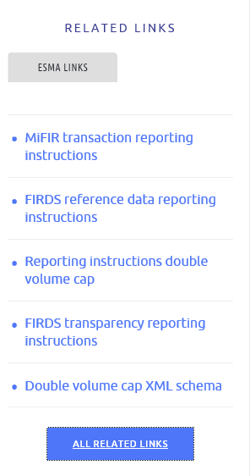
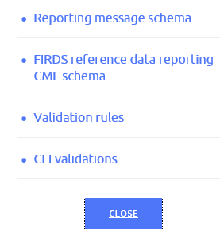
4. Information from ESMA
ESMA:
https://www.esma.europa.eu/policy-rules/mifid-ii-and-mifir/mifir-reporting-instructions
Expand links below to get
eg. Reporting message schema
Notes:
ABU-slide

Slide 21
5. AOB
Notes:
ABU-slide

