Slide 1
IT solution for reporting MiFIR Transactions
1-12-2016 - Finanstilsynet

Slide 2
Agenda
Welcome
Transaction reporting under MiFIR
System overview and time schedule
IT solution
Technical setup
Functionality
Test XML - My standards
Information og communication
Finanstilsynet’s homepage
ESMA homepage (how do you find what you need)
Mailing list
Next meeting
AOB

Slide 3
2. MiFIR Transaction Reporting
MiFID -> MiFID II/MiFIR
Regulatory Technical Standard (RTS 22)
Guidelines on Transaction Reporting
MiFIR Transaction Reporting Instructions
ISO 20022
Reference data (FIRDS)

Slide 4
3. System overview
Submitting firm
TRS II
ESMA
Other CA’s TRS
Reference data
Submitting firm reporting system
Data reception
Transaction exchange
Transaction
exchange
Data reception
Internal systems
Internal systems

Slide 5
3. Description of system overview
Each submitting entity will need to implement a reporting system that will be submitting transaction reports to CAs in the specified format ISO20022
CAs shall implement a data reception system that will receive data from the submitting entities. This system shall validate the compliance of the transaction reports with the common format and common validation rules as well as provide feedback to the submitting entities
Transaction exchange: this component shall implement the common set of rules with regard to transaction reports exchange between CAs. The data format and validation rules should be the same as for the data reported by submitting entities (except for minor technical differences)

Slide 6
3. TRS II Expected release plan
Release 1
The TRS II is ready for external testing by submitting entities. They are able to send and receive data. This includes validation based on reference data created by the project
Release 1,5
The TRS II is ready for testing exchange of data with other competent authorities and for receiving reference data from ESMA. Validation is updated to use reference data from ESMA
Release 2
The TRS II is ready to comply with EU regulations and security standards and regulations (data protection)
April 2017
September 2017
November 2017

Slide 7
3.Test Expected Time Schedule
Start date | End date | Test
Apr. 2017 | Sep. 2017 | Test of connection and validation (simple test reference data)
Sep. 2017 | Nov. 2017 | Test with reference data from ESMA
Nov. 2017 | Dec. 2017 | Pre-production
03-01-2018 | - | Go-live, Production

Slide 8
4. Settings, configuration
Use of SFTP,
based on ftp setup.
Folder setup much like today but folder names may change.
Use of LEI instead of BIC.
Exchange of information before test of connection:
LEI code
IP address for firewall openings
Contact persons
Key exchange for SFTP
Encryption information (not decided yet)

Slide 9
4. Transaction and feedback files
A transaction file is first checked for file errors such as syntax and schema validation. If errors are found, the whole file is rejected with an error code FIL-XXX. FIL-105 covers schema validation errors.
Then the content is checked (valid LEI, country code etc). Errors will result in CON-YYY content error codes per TR. Only the affected TR is rejected, not the other TRs in the file.
The system will try to capture as many errors as possible per TR. One should however be aware, that the validation rules is made of different layers. If one layer of validation rules results in an error the validation rules from the following layers will not be applied. As a consequence you might receive a feedback file that contains more errors after you resubmit and correct TR
A transaction file can also be without errors and all transactions are accepted.
It is recommended to send 1 or 2 files per dag. Especially it is not recommended to have only one TR per submitted file.

Slide 10
4. Transactions (TR=Transaction Report)
The following can happen for each TR received:
The trade was done the same date as the reporting (R=T). Validation of the TR is postponed one day (T+1) until reference data for the day T has been received. Status of TR is received.
The trade is made previously (R>T). The trade is accepted.
The trade is made previously (R>T). The trade is rejected because of content error.
The trade is made previously (R>T). The trade was validated and accepted except that the ISIN is not present in the reference data. The trade is parked with a grace period of up to 7 days. It is accepted if the ISIN becomes valid for the data of the trade within the grace period; otherwise it is rejected.
Notes:
R; T notation is known from guidelines MiFID II transaction reporting. See chapter 8 Annexes.

Slide 11
4. Feedback (Status Advice)
A single feedback file per transaction file received
Additional feedback file per day in case further feedback is needed. The daily feedback file will contain feedback concerning:
TR, which was not validated previously since reference data were not available (received state).
TR, which has been parked because of missing ISIN instrument in reference data (parked state). Note that in the case R=T TR will always get status as recieved. It is legal to report T+1 (MiFIR Art. 26 (1) ). TR can be accepted immediately if the TR is sent T+1 and the reference data is available from ESMA.
Note that a feedback file can have feedback for TRs from different transaction files.

Slide 12
4. File naming convention
Transaction file: TR_SEIC_ORI_YYYYMMDD_SEQ.TYPE
Segment | Content
TR | Literal, stands for ”Transaction Report”
SEIC | Submitting Entity Identification Code. Legal entity identifier (LEI) as defined in ISO 17442 (20 alphanumerical characters).
ORI | The originating system or department of the file. A 2-digit number. 00 = The TRSII system. Reserved for future use. 01...99 = Department or system at the SE. Used for uploaded files or files sent from a SERS (automated). The number uniquely specifies the department that created and sent the file.
YYYYMMDD | Date the file was created by the Submitting Entity.
SEQ | Sequence number. A 4-digit sequence number [0000-9999]. Starts over every day.
TYPE | File type. File type accepted will be configurable. We expect zip but not yet finalised.

Slide 13
4. File naming convention
File feedback: FF_TR_SEIC_ORI_YYYYMMDD_SEQ_VER.TYPE or FF_<Full name of received file>
Segment | Content
FF | Literal. Stands for ”Feedback on File”
SEQ | Sequence number; same as original transaction file
VER | Version number. Probably 1 digit
Daily feedback: FD_TR_SEIC_ORI_YYYYMMDD_SEQ.TYPE
Segment | Content
FD | Literal. Stands for ”Feedback, Daily”
SEQ | Sequence number; generated by TRSII
Note the use of ORI in the daily feedback. This means that using different ORI in the TR file will cause different daily feedback files.

Slide 14
4. Creation, updates, cancellations
A TR can be both creation of a new trade or it can be a cancellation of an already submitted TR.
Changing or updating of a trade previously submitted is done by canceling the trade and sending the updated transaction. That is an update of a trade is not possible.
The same reference number can be used over and over again for the changes and updates to the same trade. As opposed to the current reporting system where the same reference number cannot be reported again.
In fact it is required that the reference number is used again if it is the same trade that has just been updated.

Slide 15
4. Content error code samples:
se also ”2016-ITMG-66 - Annex 1 Validation rules_v1.1.xlsx” on ESMA homepage
Code | Error text
CON-023 | Transaction report with the same transaction reference number has already been sent for the firm and not cancelled
CON-040 | The executing entity LEI is not valid
CON-071 | Buyer national identification code XXX does not include valid country code
CON-162 | Seller MIC XXX is not valid for the trade date
CON-290 | When using 'DEAL' either Buyer or Seller should be identical with the executing entity identification code
CON-340 | Currency code is not valid for the trade date
CON-370 | Country of branch membership is missing
CON-381 | Up-front payment is missing
CON-450 | Notional currency 2 was populated but Notional currency 1 is missing.
Notes:
note XXX represent the value. The MIC XXXX is actually a valid MIC code.
290:When using 'DEAL' Buyer Identification or Seller Identification or both of them should be identical with the executing entity identification code.
381:In case the CFI code is available in the instrument reference data (transaction in an instruments admitted to trading): Field is mandatory where the CFI of the instrument in the reference data is SC**** (CDS)
370:This field is mandatory where: Field 36 is an EEA trading venue or trading platform outside the Union
450: Field can be only populated when field 44 was also populated
610: This field should NOT be populated where: 1. Field 36 is 'XOFF', 'XXXX' or a non-EEA venue

Slide 16
4. XML feedback sample 1
<?xml version="1.0" encoding="UTF-8"?>
<Document xmlns="urn:iso:std:iso:20022:tech:xsd:auth.031.001.01" xmlns:xsi="http://www.w3.org/2001/XMLSchema-instance" xsi:schemaLocation="urn:iso:std:iso:20022:tech:xsd:auth.031.001.01 auth.031.001.01.xsd">
<FinInstrmRptgStsAdvc>
<MsgStsAdvc>
<MsgRptIdr>TransactionFile1</MsgRptIdr>
<MsgSts>
<RptSts>PART</RptSts>
<RefDt>2016-01-05</RefDt>
<Sttstcs>
<TtlNbOfRcrds>8</TtlNbOfRcrds>
<NbOfRcrdsPerSts>
<DtldNbOfTxs>3</DtldNbOfTxs>
<DtldSts>PDNG</DtldSts>
</NbOfRcrdsPerSts>
<NbOfRcrdsPerSts>
<DtldNbOfTxs>2</DtldNbOfTxs>
<DtldSts>RJCT</DtldSts>
</NbOfRcrdsPerSts>
<NbOfRcrdsPerSts>
<DtldNbOfTxs>3</DtldNbOfTxs>
<DtldSts>ACPT</DtldSts>
</NbOfRcrdsPerSts>
</Sttstcs>
</MsgSts>
Notes:
My Standard reference

Slide 17
4. XML feedback sample 2
<RcrdSts>
<OrgnlRcrdId>00987654321009876543Txn1-3</OrgnlRcrdId>
<Sts>RJCT</Sts>
<VldtnRule>
<Id>CON-411</Id>
<Desc>Instrument Inst1 is not valid in reference data on transaction date</Desc>
<Issr>Entity</Issr>
</VldtnRule>
</RcrdSts>
<RcrdSts>
<OrgnlRcrdId>00987654321009876543Txn1-51</OrgnlRcrdId>
<Sts>PDNG</Sts>
<VldtnRule>
<Id>CON-412</Id>
<Desc>Pending instrument Inst5 validation</Desc>
</VldtnRule>
</RcrdSts>

Slide 18
4. Responsibilities of Submitting Entity & Executing Entity
Missing feedback file from TRSII is no excuse not to keep reporting
SE must ensure that all feedback files are analysed and all reports are corrected
Updating of a Transaction Report (TR) requires reuse of the Transaction Reference Number.
If a TR has been accepted by TRSII (in DK) but failed after exchanging with other Competent Authorities, then it is a manual process to correct errors. If the TR was incorrectly accepted, then Competent Authority (ie. Finanstilsynet) will ask for correction.
Notes:
Technical Reporting Instructions:
#34 Missing feedback
#37 Must analyse fb
#66 Update
#39 manual process

Slide 19
4. Environment
Two test environments will be provided as today. One which will resemble the production environment and one that will have the latest release due to be implemented in production.
We urge you NOT to send production data to the test environment. It is not on the same security level as production. And transactions could be exchanged with other countries.
You must delete feedback files from the ftp-folder after you have downloaded and read them. We will delete feedback files deemed to be too old: it may be more then two weeks old.

Slide 20
4. Test XML - MyStandard
MyStandards / Readiness Portal
The MyStandards Readines Portal will be made available for CAs and SEs to support the testing of ISO 20022 XML messages.
This tool enables the users to submit XML messages and check whether they are correctly formatted (compliant with the XML schema) and follow data quality rules. Some of the simple content validation rules will also be checked by this system (e.g. dependencies between fields). However, the Readiness Portal will not validate complex rules (e.g. the rules verifying the transaction reports against the instrument reference data, the CFI rules, etc.)
We urge you NOT to send production data to the MyStandard
Further details on the use of this tool will be provided later

Slide 21
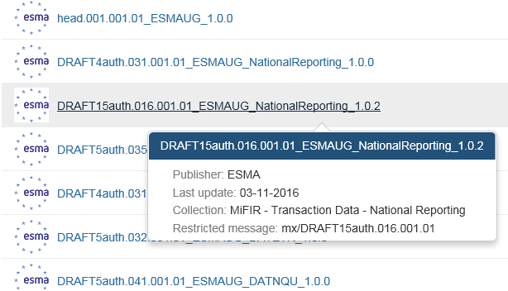
4. Test XML - MyStandard
Use MyStandards at SWIFT. ISO 20022 is described and published here: https://www2.swift.com/mystandards/#/
it is free to create a user account
Search for eg. ESMA

Slide 22
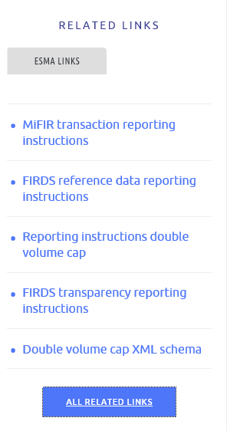
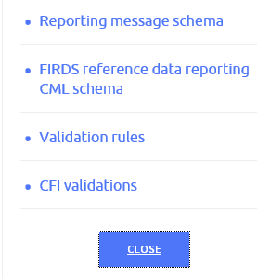
5. Information
Finanstilsynet homepage: https://www.finanstilsynet.dk/da/Lovgivning/Information-om-udvalgte-tilsynsomraader/MiFIR-TRS
ESMA:
https://www.esma.europa.eu/policy-rules/mifid-ii-and-mifir/mifir-reporting-instructions
Expand links below to get
eg. Reporting message schema

Slide 23
5. Communications and information
We continuously update our website and we would ask you to get updated information here (http://www.finanstilsynet.dk/da/Lovgivning/Information-om-udvalgte-tilsynsomraader/MiFIR-TRS)
We also have a mailbox where questions can be directed to
MiFIR-TRS@ftnet.dk
Mailing list – be sure you are on the mailing list – preferably using a shared mail. (write to our MiFIR-TRS mailbox if any changes)

Slide 24
6. Next meeting
Next meeting: Test start meeting in early March - we will explain how the test will proceed.
You will get an invitation at the beginning of 2017 by email. The invitation will also be published on our homepage.

Slide 25
7. AOB

